Slide 1

Wireless Sensor Network Health Diagnostic
David Rogers, Stu Andrzejewski,
Kelly Desmond, Brad Garrod
Design Team 2

Slide 2
Problem Statement
In order to ensure a properly functioning wireless sensor network, the Air Force needs a network health diagnostic tool that is easy to use, accurate and reliable.

Slide 3
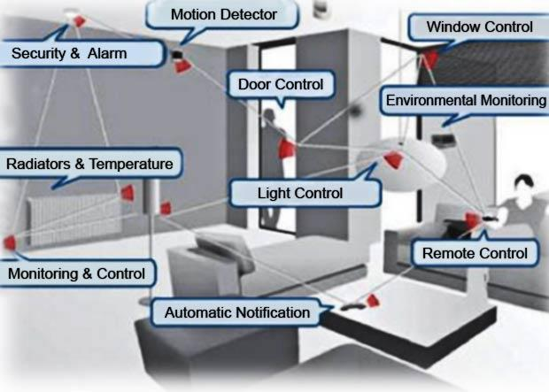
Sensors outnumber people

Slide 4
Project Goals
Configure a state of the art wireless sensor network.
Be able to collect the data from the network.
Design and Develop a software package for displaying sensor data in real time.
Develop algorithms that help analyze the correlations between network metrics and node failure.
SET GOALS.
MAKE PLAN.
REACH GOALS.
GET TO WORK.
STICK TO IT.

Slide 5

Specifications & Requirements
Must Be Satisfied
Fully Configured Wireless Sensor Network
Low Power Sensor Nodes
Reliable Communication with and within the Network
Accurate Sensor Node Measurements
Increases Design Desirability
Simple Network Configuration
Development of Graphical User Interface

Slide 6
Final Design
Hardware
Powercast P2110-Eval-01
Software
Graphical User Interface (modified MVC)
Controller (pySerial)
Model
View (wxPython, Matplotlib)
Metric Analysis Algorithms
Short Term
Long term
Zero Value

Slide 7
Final Design
Hardware
Powercast P2110-Eval-01
Software
Graphical User Interface (modified MVC)
Controller (pySerial)
Model
View (wxPython, Matplotlib)
Metric Analysis Algorithms
Short Term
Long term
Zero Value

Slide 8
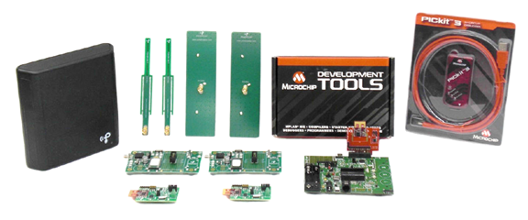
Powercast P2110-EVAL-01 Development Kit
Goal #1:
Configure a state of the art wireless sensor network
Power and Data Transmitter
(2) P2110 Evaluation Board
(2) Patch Antennas
(2) Dipole Antennas
(2) Wireless Sensor Board
Microchip 16-bit XLP Development Board
Microchip MRF24J40 PICtail
PICkit Programmer/Debugger

Slide 9
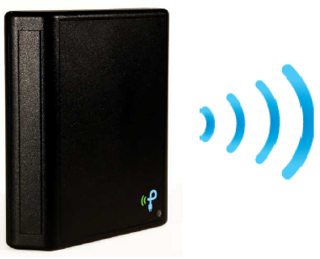
915 MHz Powercaster Transmitter
915MHz ISM band
Transmits power and data
Outputs 3 watts
Transmits transmitter ID
8dBi integrated antenna
Capable of wall or table mount
Beam Pattern-60° width, 60 ° height
Wide temperature range
Ability to power multiple receivers

Slide 10
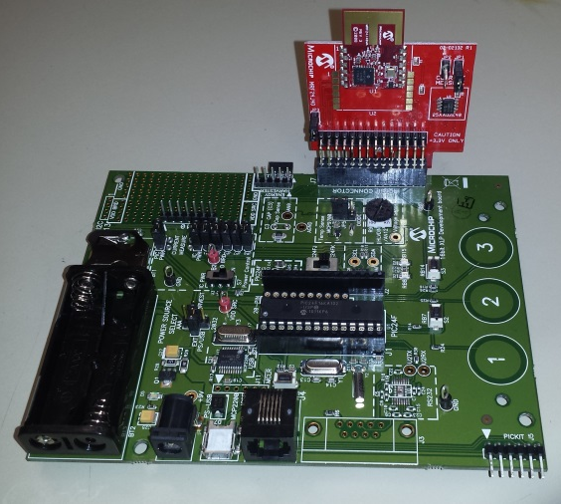
Microchip 16-Bit XLP Development Board
Contains a PIC24FK embedded MCU
2.4 GHz Radio Module
Configured for up to eight sensor nodes
Maintains time counters for each node
Configuration selection jumpers to disable board components
USB connectivity
Two user-defined LEDs
Built-in capability for separately measuring microcontroller and component current consumption

Slide 11
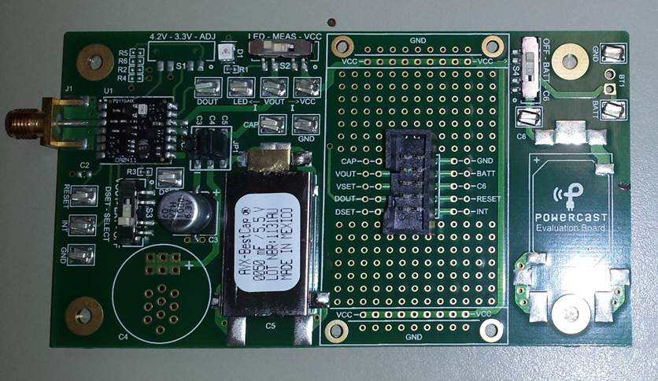
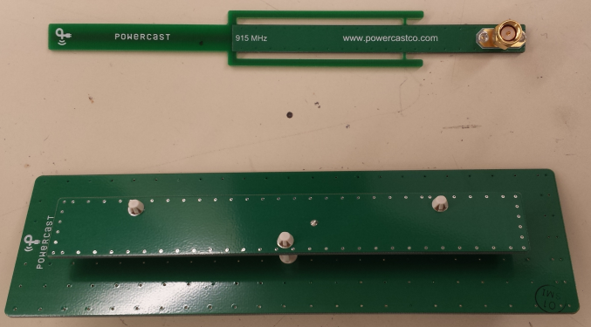
P2110 Evaluation Board & Antennas
P2110 Evaluation Board
P2110 Powerharveter
Converts RF energy to regulated DC power
Charge/Power Management
I/O for interface to MCU
Antennas
Dipole (360° Reception Pattern – Omni-Directional)
Patch (120° Reception Pattern - Directional)

Slide 12
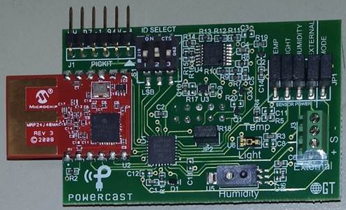
Wireless Sensor Boards
Node ID Selection
Transmitter ID Capture
Sensors
Temperature
Light
Humidity
External Sensor Port
RSSI Calculation
PIC Embedded MCU
2.4 GHz Radio Module
Sensors

Slide 13
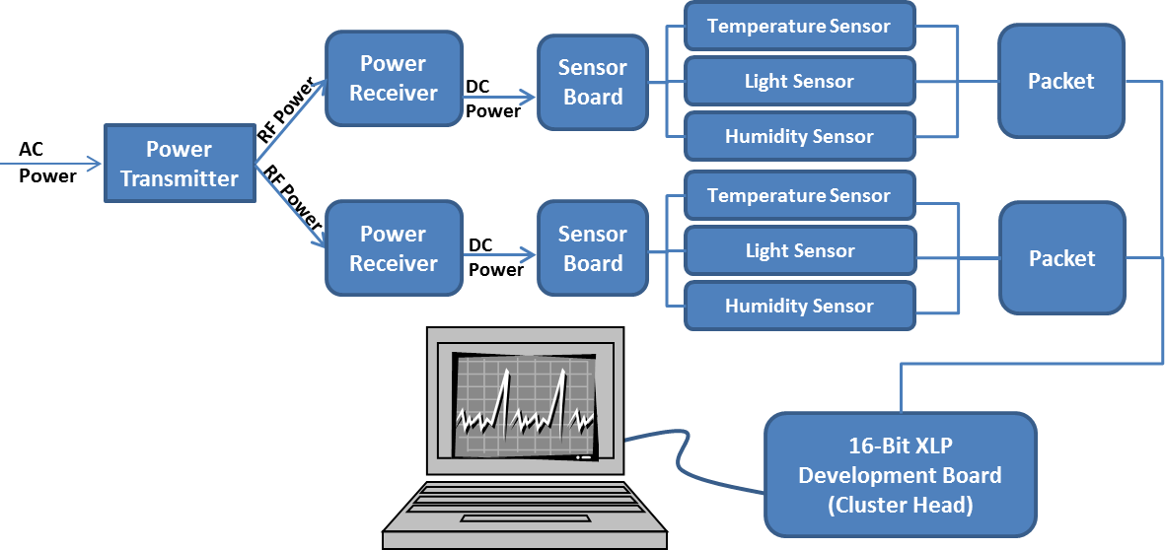
Wireless Sensor Network Flowchart

Slide 14
Hardware Testing
Test Name | Sensor Node Position (Angle in Relation to Transmitter) |  | Transmitter (Height & Distance from Sensor Nodes) |  | Sensor Status (Jumper Pins Pulled On Certain Sensors) |  |  | Test Time
 | Height | Width | Distance | Height | Temperature | Light | Humidity
Sample2-3 | 3.97° | 0° | 3ft | 2.5 inches | Not Active | Active | Active | 30 mins
Sample2-4 | 3.97° | 0° | 3ft | 2.5 inches | Active | Not Active | Active | 30 mins
Sample2-5 | 3.97° | 0° | 3ft | 2.5 inches | Not Active | Active | Not Active | 30 mins
Sample2-6 | 3.97° | 0° | 3ft | 2.5 inches | Not Active | Not Active | Not Active | 30 mins
Sample2-7 | 15.25° | 0° | 8ft | 4ft | Active | Active | Active | 45 mins
Sample2-8 | 0° | 0° | 2ft | 0ft | Active | Active | Active | 2 hr
Sample2-9 | 0° | 48.5° | 2.67ft | 0ft | Active | Active | Active | 30 mins

Slide 15
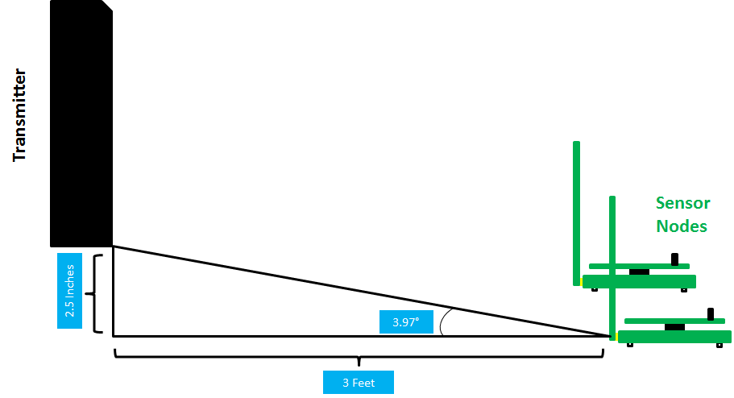
Hardware Testing

Slide 16
Final Design
Hardware
Powercast P2110-Eval-01
Software
Graphical User Interface (modified MVC)
Controller (pySerial)
Model
View (wxPython, Matplotlib)
Metric Analysis Algorithms
Short Term
Long term
Zero Value

Slide 17
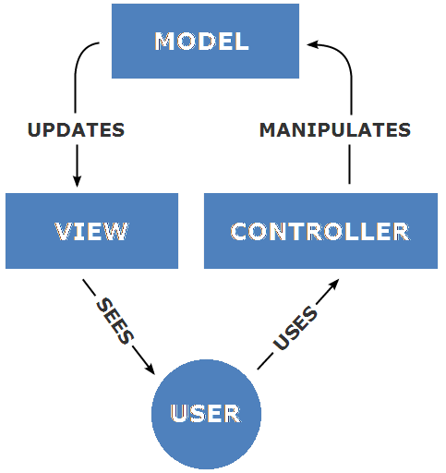




Graphical User Interface - MVC
Goal #2:
Be able to collect the data from the network.
Goal #3:
Design and develop a software package for displaying sensor data in real time.
Model-View-Controller (MVC)
Design Pattern

Slide 18
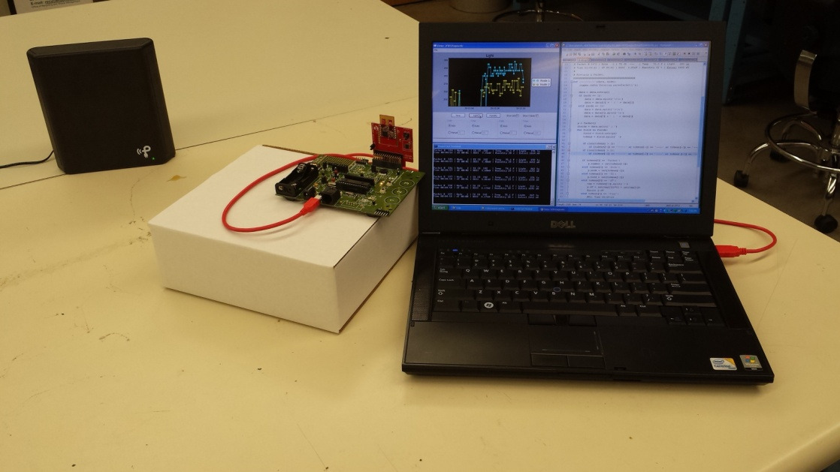
Controller
Launch the application in a specific mode
Demo or Real-time
Main Functions:
Collect data from the network over USB (pySerial)
Manipulates data into individual packets
Notes:
A controller can send commands to the model to update the model's state (e.g., editing a document). It can also send commands to its associated view to change the view's presentation of the model (e.g., by scrolling through a document).

Slide 19
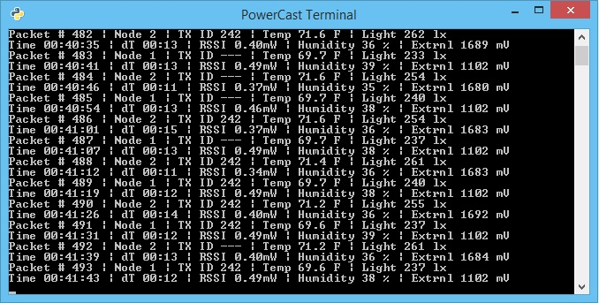
Real-time Data Close-Up

Slide 20
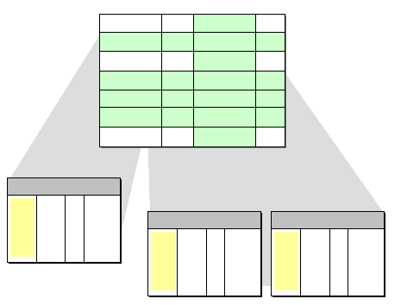
Model
Manipulates and maintains data packets sent from controller
Application programming interface (API)
Acts like a database
Allows for metric analysis integration
Able to manage streaming data in real-time efficiently
Notes:
A model notifies its associated views and controllers when there has been a change in its state. This notification allows the views to produce updated output, and the controllers to change the available set of commands.

Slide 21
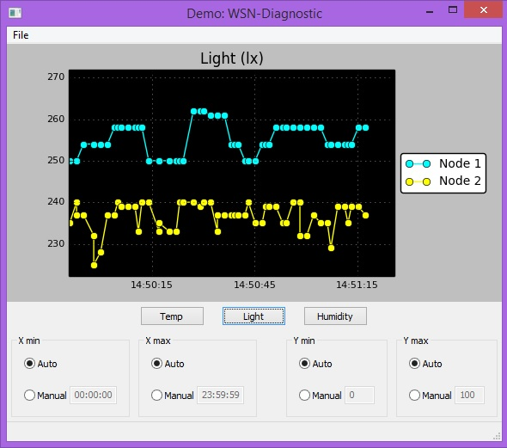
View
Run concurrently on its own thread
Robust to crashes
Leverages multiple libraries
wxPython
Matplotlib
Features:
Saving plots
Manual & Auto scaling
Display multiple nodes simultaneously
Switch between metrics
Notes:
A view requests information from the model that it needs for generating an output representation to the user

Slide 22
Minimum Viable Product
The application running in demo mode with data from sample2-3

Slide 23
Final Design
Hardware
Powercast P2110-Eval-01
Software
Graphical User Interface (modified MVC)
Controller (pySerial)
Model
View (wxPython, Matplotlib)
Metric Analysis Algorithms
Short Term
Long term
Zero Value

Slide 24
Metrics Analysis Approach
Goal #4:
Develop algorithms that help analyze the correlations between network metrics and node failure.
Function approach to minimize time
Parse through packet data
Grab appropriate data
Filter into readable data sets
Convert into comma separated value file
Read and analyze data
Plot graphs
Calculate averages
Determine thresholds

Slide 25
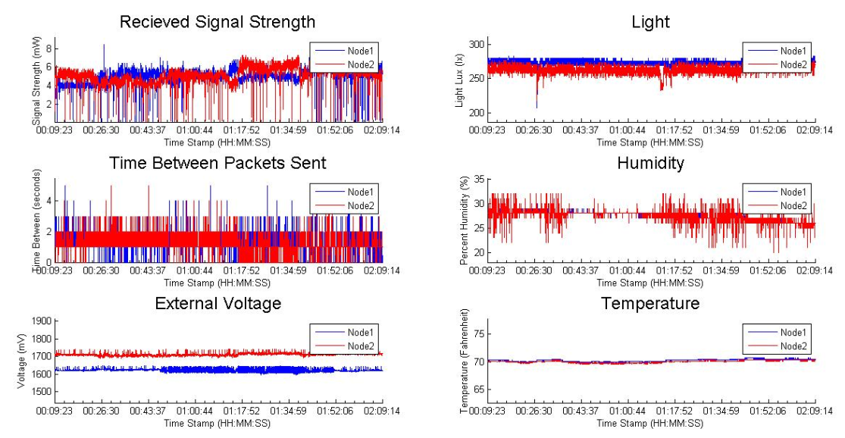
Metric Analysis Results

Slide 26
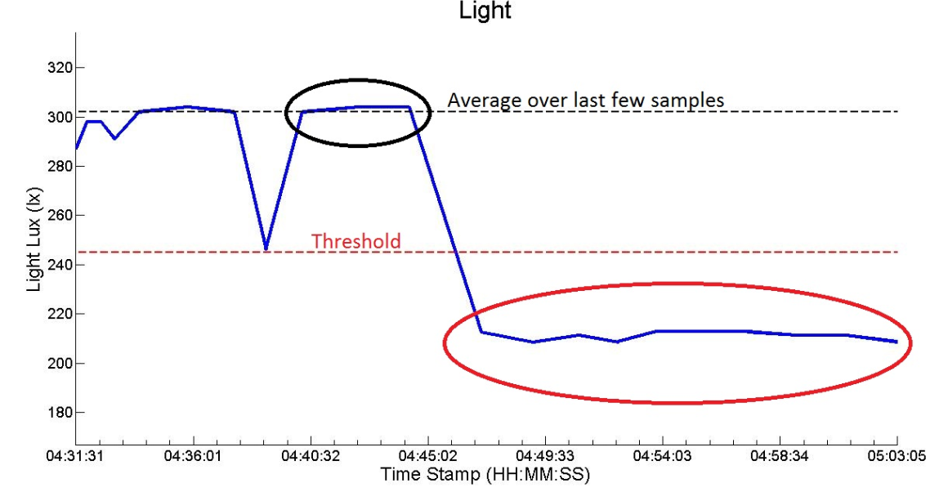
Short Term Failure
Primarily external sensors
Data against average for past 4 samples

Slide 27
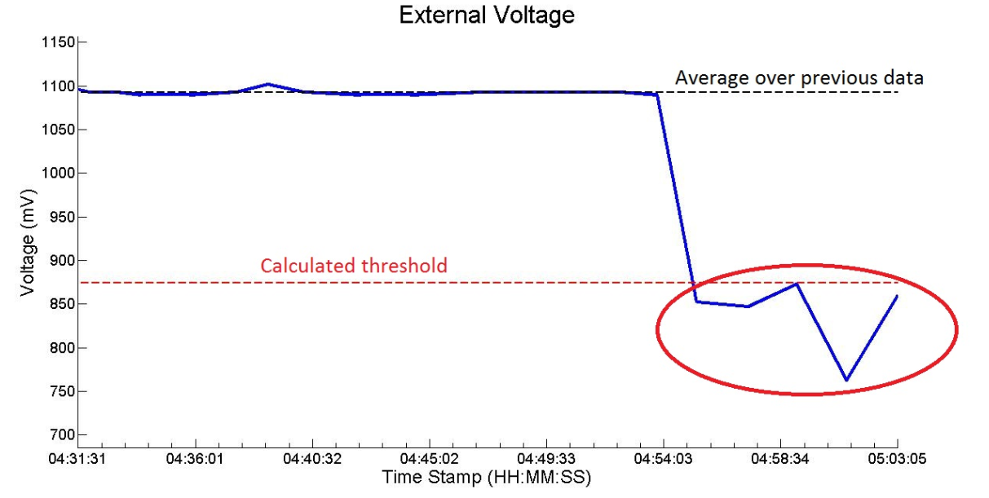
Long Term Failure
Primarily internal sensors
Data against average for large chunk of past data

Slide 28
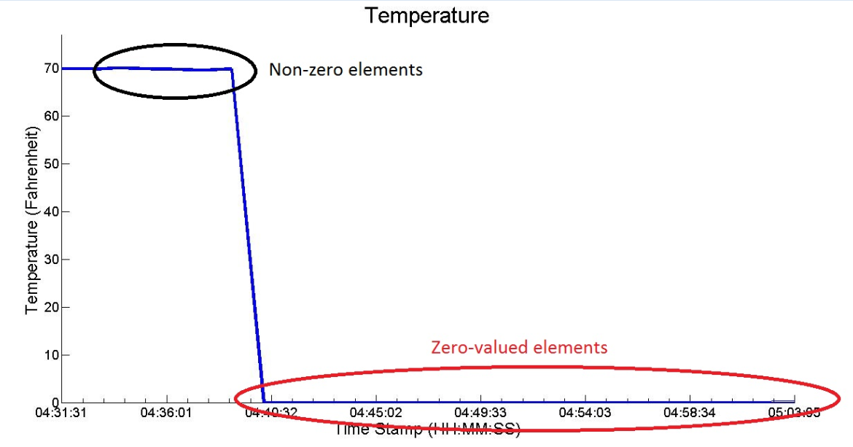
Zero Value Failure
Can be used for any sensor
Looks for unexpected zeros in data

Slide 29
Final Design
Hardware
Powercast P2110-Eval-01
Software
Graphical User Interface (modified MVC)
Controller (pySerial)
Model
View (wxPython, Matplotlib)
Metric Analysis Algorithms
Short Term
Long term
Zero Value

Slide 30
Budget
Product | Cost
Powercast P2110 EVAL-01 Development Kit | $1250
Total | $1250

Slide 31
http://www.egr.msu.edu/classes/ece480/capstone/fall13/group02/

